Slide 1
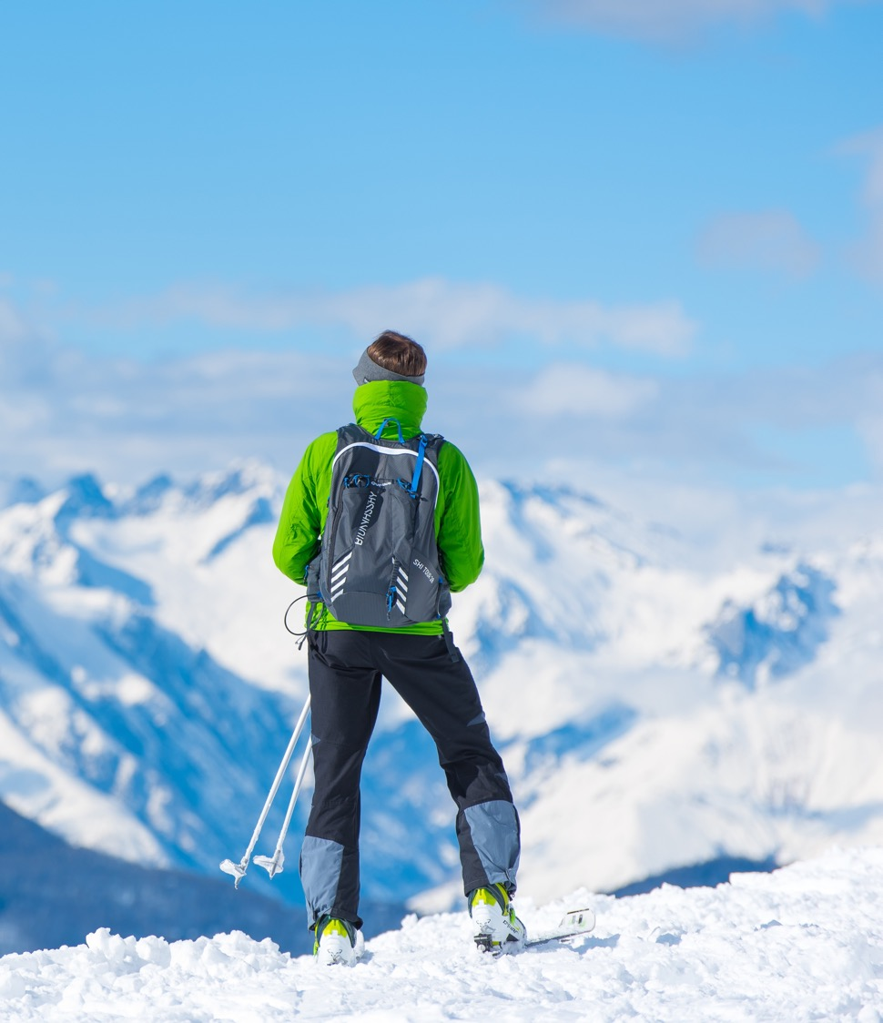
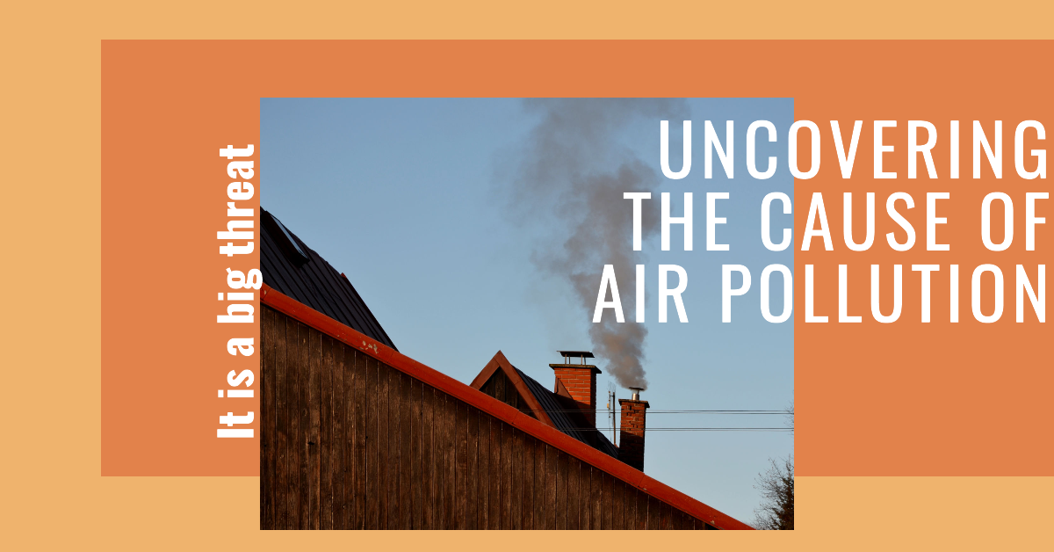
ALPINE SKI HOUSE
WWW. ALPINESKIHOUSE.COM

Slide 2
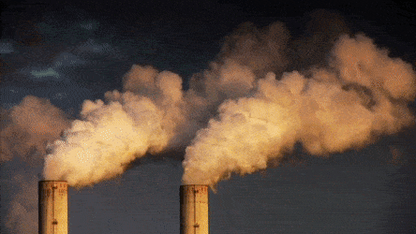

Slide 3
What is Air Pollution?
Air pollution is the presence of substances in the air that are harmful to human health and the environment. These substances can come from natural sources such as volcanic eruptions or wildfires, but most air pollution is caused by human activities such as burning fossil fuels and industrial processes.

Slide 4
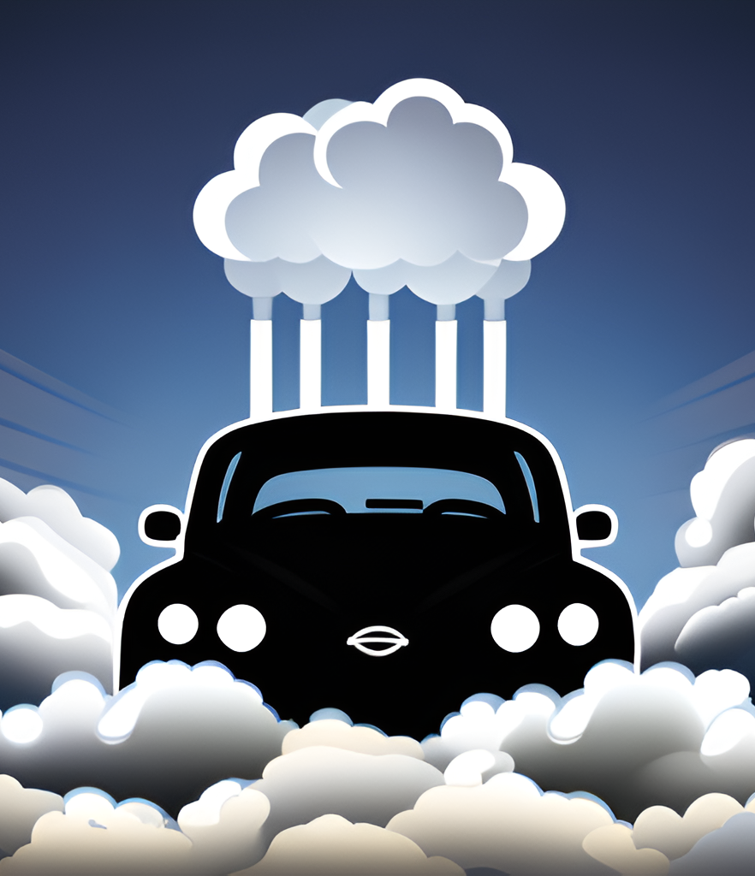
Air pollution because of Vehicles
Air pollution is a big problem these days. One of the main causes is vehicles. They emit harmful gases like carbon monoxide and nitrogen oxides. These gases can affect our health and the environment. We should try to use public transportation or bikes more often to reduce air pollution.

Slide 5
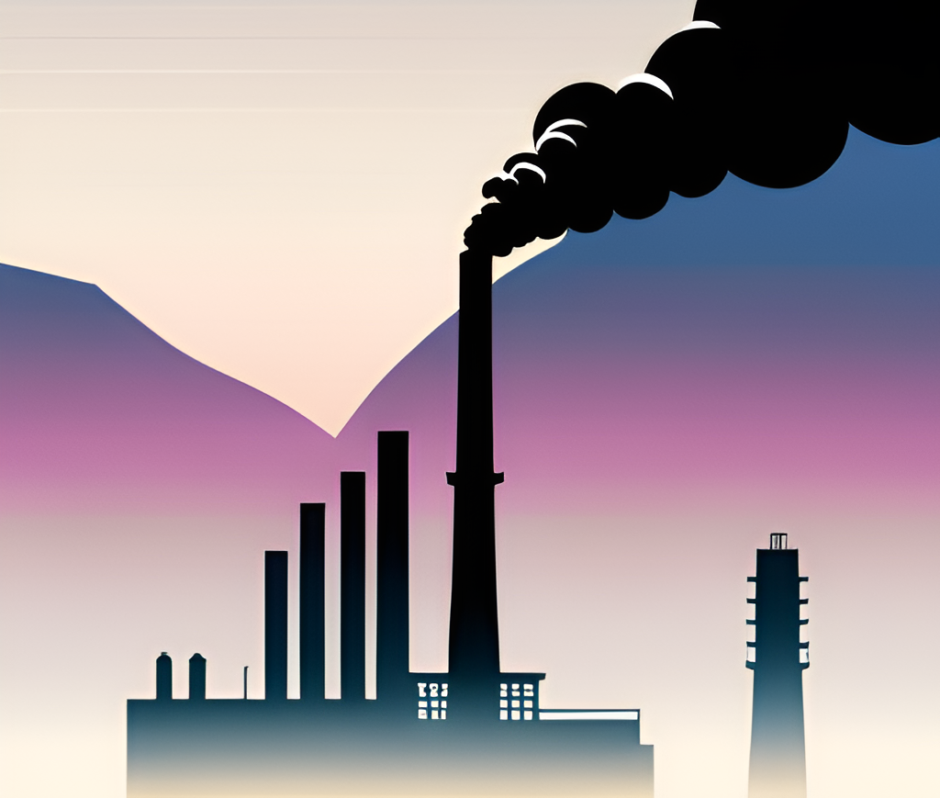
Air pollution because of Industrialization
Air pollution is a big problem these days. It's mostly caused by industrialization, which means more factories, more cars, and more smoke. This stuff is bad for our health and the environment. We need to find ways to reduce air pollution and use cleaner energy sources.

Slide 6
Air pollution because of Deforestation
Deforestation is one of the major causes of air pollution. Trees absorb carbon dioxide and other pollutants from the air, but when they are cut down or burned, they release these harmful substances back into the atmosphere.

Slide 7
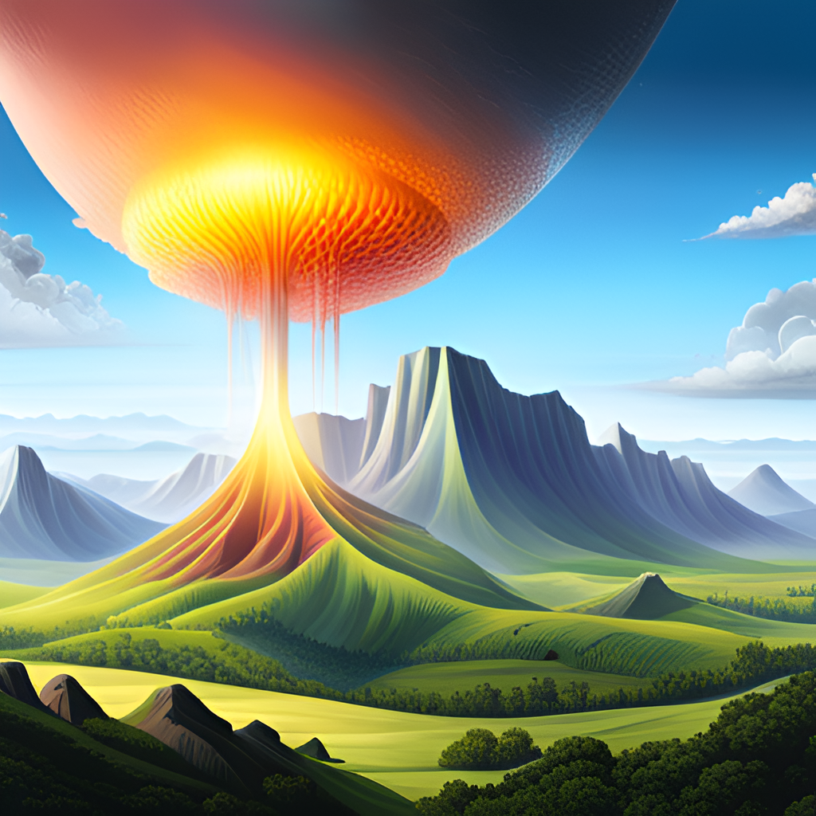
Air pollution is the cause of acid rain!
Acid rain is a phenomenon that occurs when sulfur dioxide and nitrogen oxides are released into the atmosphere by burning fossil fuels. These pollutants can react with water, oxygen, and other chemicals in the air to form acidic compounds, which then fall back to the earth as acid rain.

Slide 8
The top polluters in the world are:
China
United States
India
Russia
Japan

Slide 9
The end

Slide 10
Any Doubts?

